Slide 1
EXECUTIVE COUNCIL MEETING
May 22, 2025
Lucas Womack

Slide 2
AGENDA
Call to Order
Cocktail Presentation
Warm-up Album One Presentation
Old Business: Review & Approval of the Minutes
New Business: New Music, Books, & Video; New Purchases; Concerts; etc.
Warm-up Album Two Presentation
Musicology
Headliner Album Presentation
Wrap Up

Slide 3
CALL TO ORDER
Executive Officers
Chris Clement
Joe Ziegler
John Williams
Janitor
Lucas Womack
Regional Manager
Adam Scott
Guests
Adam Gorsuch
Katie Vancs
Chris Cedar

Slide 4

COCKTAIL PRESENTATION
Division Bell
1 ounce mezcal (preferably Del Maguey Vida)
3/4 ounce Aperol
1/4 ounce maraschino liqueur (preferably Luxardo)
3/4 ounce lime juice, freshly squeezed
Garnish: grapefruit twist
Steps:
Add all ingredients into a shaker with ice and shake until well-chilled.
Strain into a chilled coupe glass.
Express the oils from a grapefruit twist over the drink, then discard the twist.

Slide 5
COCKTAIL PRESENTATION
Division Bell
The Division Bell is an update to the gin-based Last Word the substitutes mezcal for gin and Aperol for Green Chartreuse. Created by Phil Ward (who also created the Oaxaca Old Fashioned) for Mayahuel as part of a push to add 20 tequila and mezcal drinks on the menu.l

Slide 6
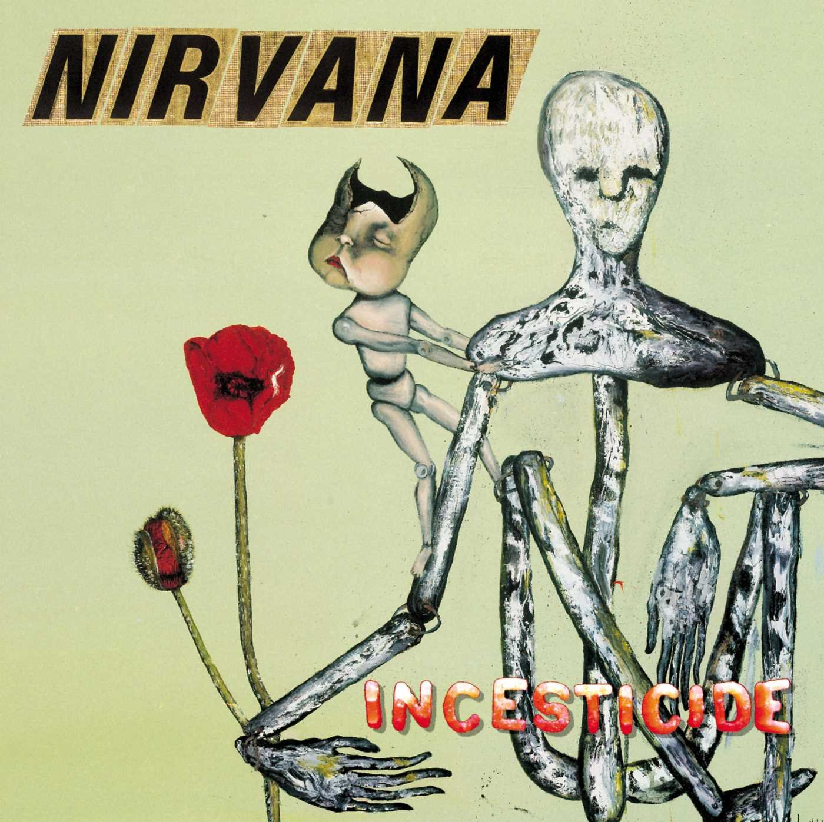
WARM-UP ALBUM ONE
Nirvana - Incesticide
Released: December 14, 1992
Recorded: January 23, 1988 – November 9, 1991 (no studio)
Label: DGC Records
Producer(s): Miti Adhikari, Dale Griffin, Jack Endino, Steve Fisk, Butch Vig

Slide 7
WARM-UP ALBUM ONE
Nirvana – Incesticide
The songs that became Incesticide started as a catalog of unreleased songs still owned by Sub Pop records. Sub Pop considered releasing the songs as an album named Cash Cow but Nirvana felt that the release needed to release under Geffen to receive maximum exposure. Sub Pop sold the songs to Geffen on the condition the band would release an album by Christmas.
The songs on Incesticide were already circulating on concert bootleg but the band wanted to offer fans a higher quality alternative and Kurt Cobain was enticed to create the album with the promise of complete control of the albums art.
The album itself contains a collection of b-sides, covers and outtakes. Since the recordings occurred over a several year period, four different drummer make an appearance (Chad Channing, Dan Peters, Dale Clover and Dave Grohl).
Musically, many of the songs point to Nirvana’s more punk early influences and the songs often poke fun at machismo and the music industry at large.

Slide 8

WARM-UP ALBUM ONE
Nirvana – Interlude
Verse Chorus Verse / Sappy

Slide 9
OLD BUSINESS: REVIEW & APPROVAL OF THE MINUTES
VCL 3/13/2025 Notes
Chris' Yard flooded in Coldwater
There was a beer/whiskey tasting. Chris got Brewdog wrong
Long View Sound Updates
Updates to the sound system at Chris' place has made sound/skipping much better.
Chris is concerned about echo in the basement. Considering sound dampening.
Joe: Shut the fuck about it. Unless you're trying to be an audiophile. (Chris says he is)
A lot of wood and the wood makes it warm. This is good.
Cocktail: Bubby's Barrel-Aged Manhattan
Manhattan ingredients aged in a barrel.
Doesn't ever last a long time.

Slide 10
OLD BUSINESS: REVIEW & APPROVAL OF THE MINUTES
VCL 3/13/2025 Notes
Warm Up 1: Phantom Planet - Phantom Planet (2004)
Jason Schwartzman is great in Bored To Death
Adam has watched them once opening for Hanson
Ringo Starr is a country artist
Chris likes Sturgill Simpson?
Warm Up 2: MGMT - Loss of Life
These mofos have trust fund kid names
Joe would like to protest the lack of a Tears for Fears album in the Top 5

Slide 11
OLD BUSINESS: REVIEW & APPROVAL OF THE MINUTES
VCL 3/13/2025 Notes
Hall & Oates - Hall & Oates (Maybe the gayest cover ever)
Lots of 50 years of SNL references
Top 5 rankings
The Cure
The Smile
MJ Lenderman
Kings of Leon
IDLES

Slide 12
OLD BUSINESS: REVIEW & APPROVAL OF THE MINUTES
VCL 3/13/2025 Notes
Musicology: Bowie's Berlin Trilogy
Moogs!!!
GOAT Records in BG is small but also has almost no records
Headliner: Beatles - Magical Mystery Tour
Record that Adam's parents had from 1967
Underrated per Joe
Sturgill Simpson post listening party?
Lucas had to leave early due to gastric distress. We should consider a demotion.

Slide 13
NEW BUSINESS New Music, Video, Books, Purchases, Concerts, etc.
Joe
Listening to: Imelda May, XTC (I missed it), Randy Newman, new Bon Iver, new Eric Clapton,
Purchased: The Best of John Lee Hooker, Rod Stewart – Every Picture Tells A Story, Black Sabbath – Black Sabbath 1970, The Beach Boys – Endless Summer, Spooky Tooth – Spooky Two
Books: Miles Davis biography Randy Newman biography Mike Campbell memoir Heartbreaker Brothers – Alex Van Halen The McCartney Legacy 1974–1980 John & Paul – A Love Story in Song Peter Wolf memoir – Waiting on the Moon Tom Jones autobiography (stop throwing your underwear at me!)

Slide 14
NEW BUSINESS New Music, Video, Books, Purchases, Concerts, etc.
Joe
Documentary: Lowell George – Feats First An evening with Elton John and Brandi Carlisle

Slide 15
NEW BUSINESS New Music, Video, Books, Purchases, Concerts, etc.
Chris
Listening: All New Purchases Below
Purchased: Vinyl: 33 - They are all on wall CD’s: 5 - also on wall Cassette: None
Shows: Empire of the Sun at Fillmore on 4/23
Upcoming: NIN: 8/22; Nation of Language - 9/23; Sleep Token 9/19

Slide 16
NEW BUSINESS New Music, Video, Books, Purchases, Concerts, etc.
John
Listening - Car seat Headrest, Goose, Friendship, Wilco live Purchases - New York Dolls - New York Tapes 72-73, Joy Division-Closer, Dean Wareham-That’s the price of loving me, The Lemonheads- Lemonheads in Dreamland, Morphine-Bootleg Detroit, David Bowie-Ready! Set! Go!, John Doe-Fables in a foreign land. Shows - Hard Quartet, Goose, Dean Wareham, Ryan Adams, Neil Young & the Chrome Hearts, Beta Band Books - Henry Rollins-Sic

Slide 17
NEW BUSINESS New Music, Video, Books, Purchases, Concerts, etc.
Adam
Listening:
Jadu Heart - described as Dream Pop, Shoegaze (saw them open for Fontaines DC)
Roscoe Tripp - It Always Starts with Something (reminds me a little of Modest Mouse)
Umphrey’s Mcgee - Zonkey (amazing mashup album!)
Chemtrails - The Joy of Sects (quirky garage/punk power pop from UK)
PACKS - Melt the Honey (described as indie rock band from Toronto; honors the inventive arrangements of Guided by Voices)
Listening To:Jadu Heart - described as Dream Pop, Shoegaze (saw them open for Fontaines DC)Roscoe Tripp - It Always Starts with Something (reminds me a little of Modest Mouse)Umphrey’s Mcgee - Zonkey (amazing mashup album!)Chemtrails - The Joy of Sects (quirky garage/punk power pop from UK)PACKS - Melt the Honey (described as indie rock band from Toronto; honors the inventive arrangements of Guided by Voices)
Listening To:Jadu Heart - described as Dream Pop, Shoegaze (saw them open for Fontaines DC)Roscoe Tripp - It Always Starts with Something (reminds me a little of Modest Mouse)Umphrey’s Mcgee - Zonkey (amazing mashup album!)Chemtrails - The Joy of Sects (quirky garage/punk power pop from UK)PACKS - Melt the Honey (described as indie rock band from Toronto; honors the inventive arrangements of Guided by Voices)
Listening To:Jadu Heart - described as Dream Pop, Shoegaze (saw them open for Fontaines DC)Roscoe Tripp - It Always Starts with Something (reminds me a little of Modest Mouse)Umphrey’s Mcgee - Zonkey (amazing mashup album!)Chemtrails - The Joy of Sects (quirky garage/punk power pop from UK)PACKS - Melt the Honey (described as indie rock band from Toronto; honors the inventive arrangements of Guided by Voices)
Listening To:Jadu Heart - described as Dream Pop, Shoegaze (saw them open for Fontaines DC)Roscoe Tripp - It Always Starts with Something (reminds me a little of Modest Mouse)Umphrey’s Mcgee - Zonkey (amazing mashup album!)Chemtrails - The Joy of Sects (quirky garage/punk power pop from UK)PACKS - Melt the Honey (described as indie rock band from Toronto; honors the inventive arrangements of Guided by Voices)

Slide 18
NEW BUSINESS New Music, Video, Books, Purchases, Concerts, etc.
Lucas
Listening: MJ Lenderman, Bon Iver, Mark Pritchard/Thom Yorke, Haim, that Kanye West Hitler song but just once and I felt bad about it
Purchases: Nirvana – Incesticide, Manchester Orchestra – A Black Mile to the Surface, Bon Iver – For Emma, Forever Ago and Sable, fAble
Docs/Books: None
Shows:MJ Lenderman (5/11 - Masonic), Bloc Party (6/7 - Fox and 6/11 - Red Rocks), LCD/TVOTR (8/13 Red Rocks), Nation of Language (9/23) Father John Misty (9/25)

Slide 19

ALBUM TWO
Manchester Orchestra – A Black Mile to the Surface
Released: July 21, 2017
Recorded: Echo Mountain Recording, Elmwood West, Favorite Gentlemen, The Village
Label: Loma Vista
Producer: Catherine Marks

Slide 20
ALBUM TWO
Manchester Orchestra – A Black Mile to the Surface
A Black Mile to the Surface is Manchester Orchestra’s fifth studio album. The album is setup as cohesive record the interweaves reflections on the lead singers newborn daughter with a concept around a small mining town in South Dakota.
Manchester Orchestra shifted to the concept album format after working on the soundtrack for Swiss Army Man the prior year. The concept moved the band away from the post-hardcore sounds of their prior albums and infused them with more organic, Americana sounds.
The album was generally well received by critics as positive development in Manchester Orchestra’s sound. A few critics found that this new style didn’t play to the band's strength building songs to a crescendo but appreciated the attempt to go in a new direction.

Slide 21


Slide 22
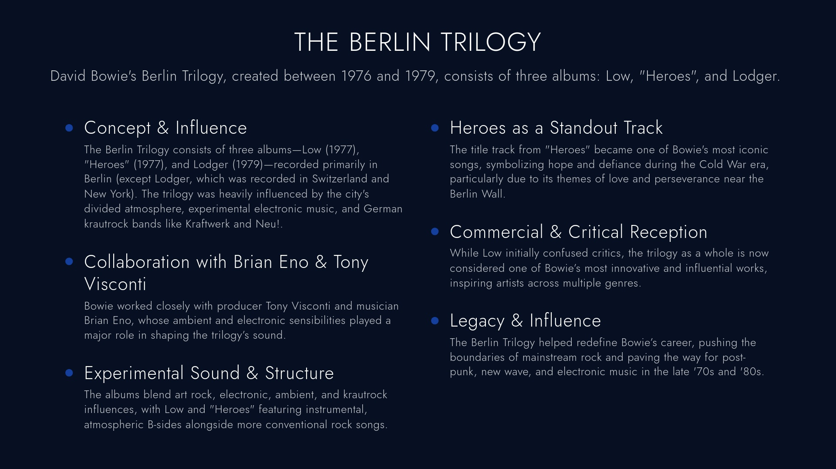

Slide 23
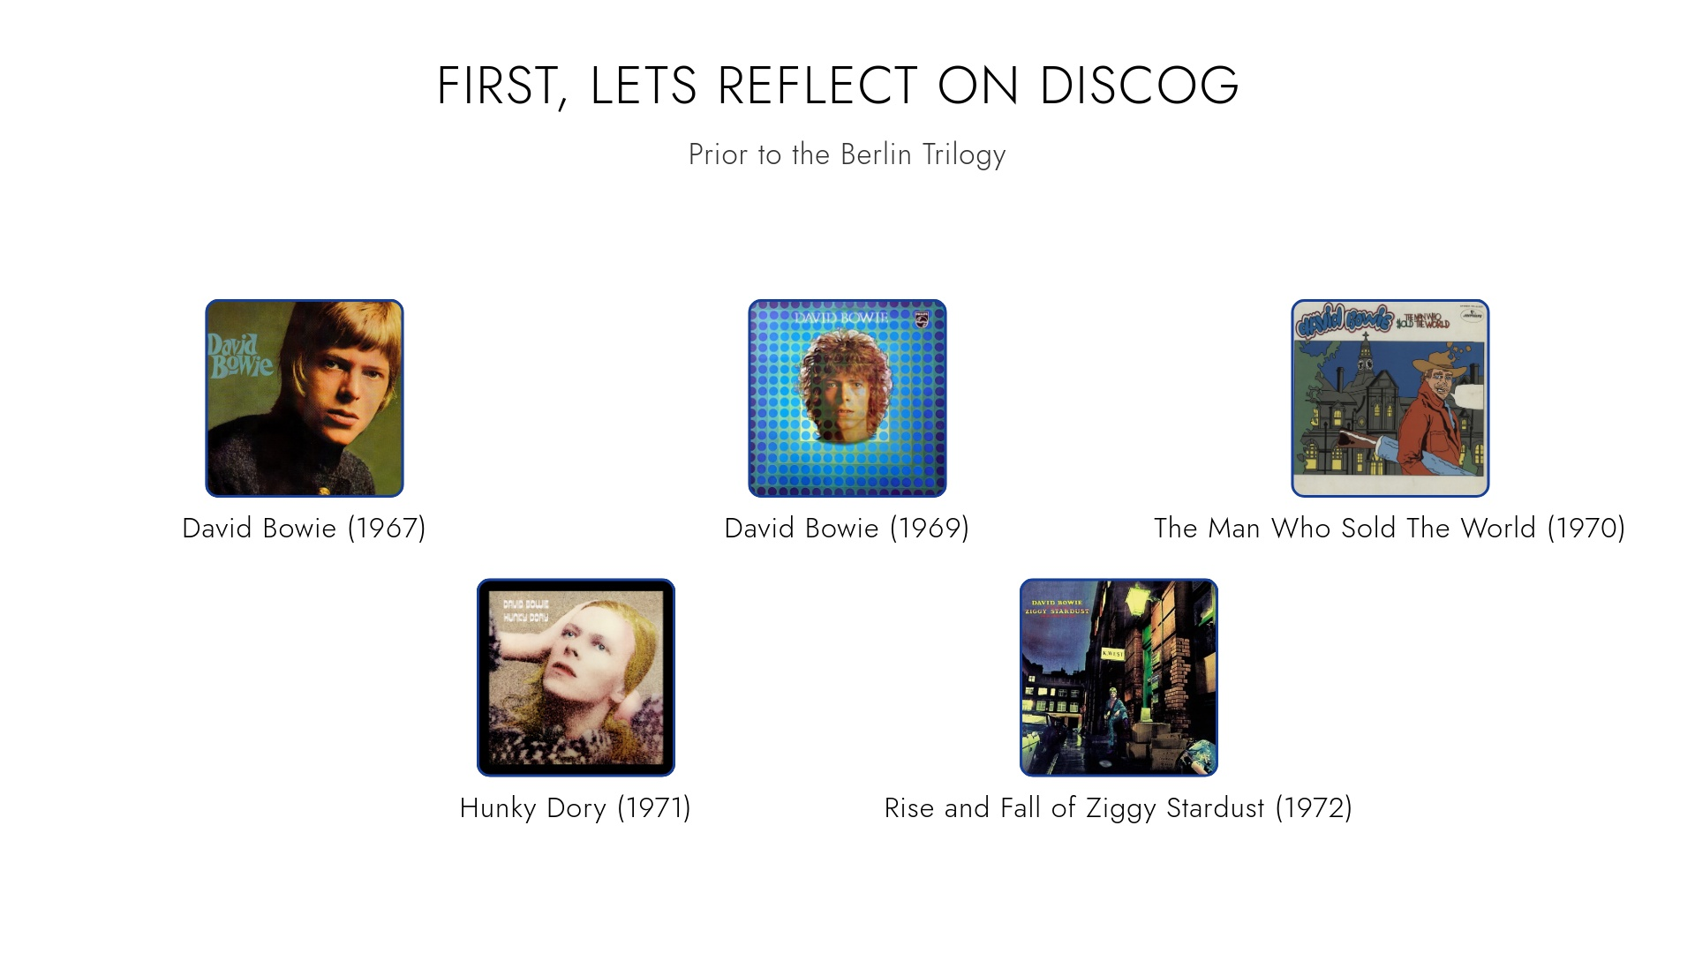

Slide 24
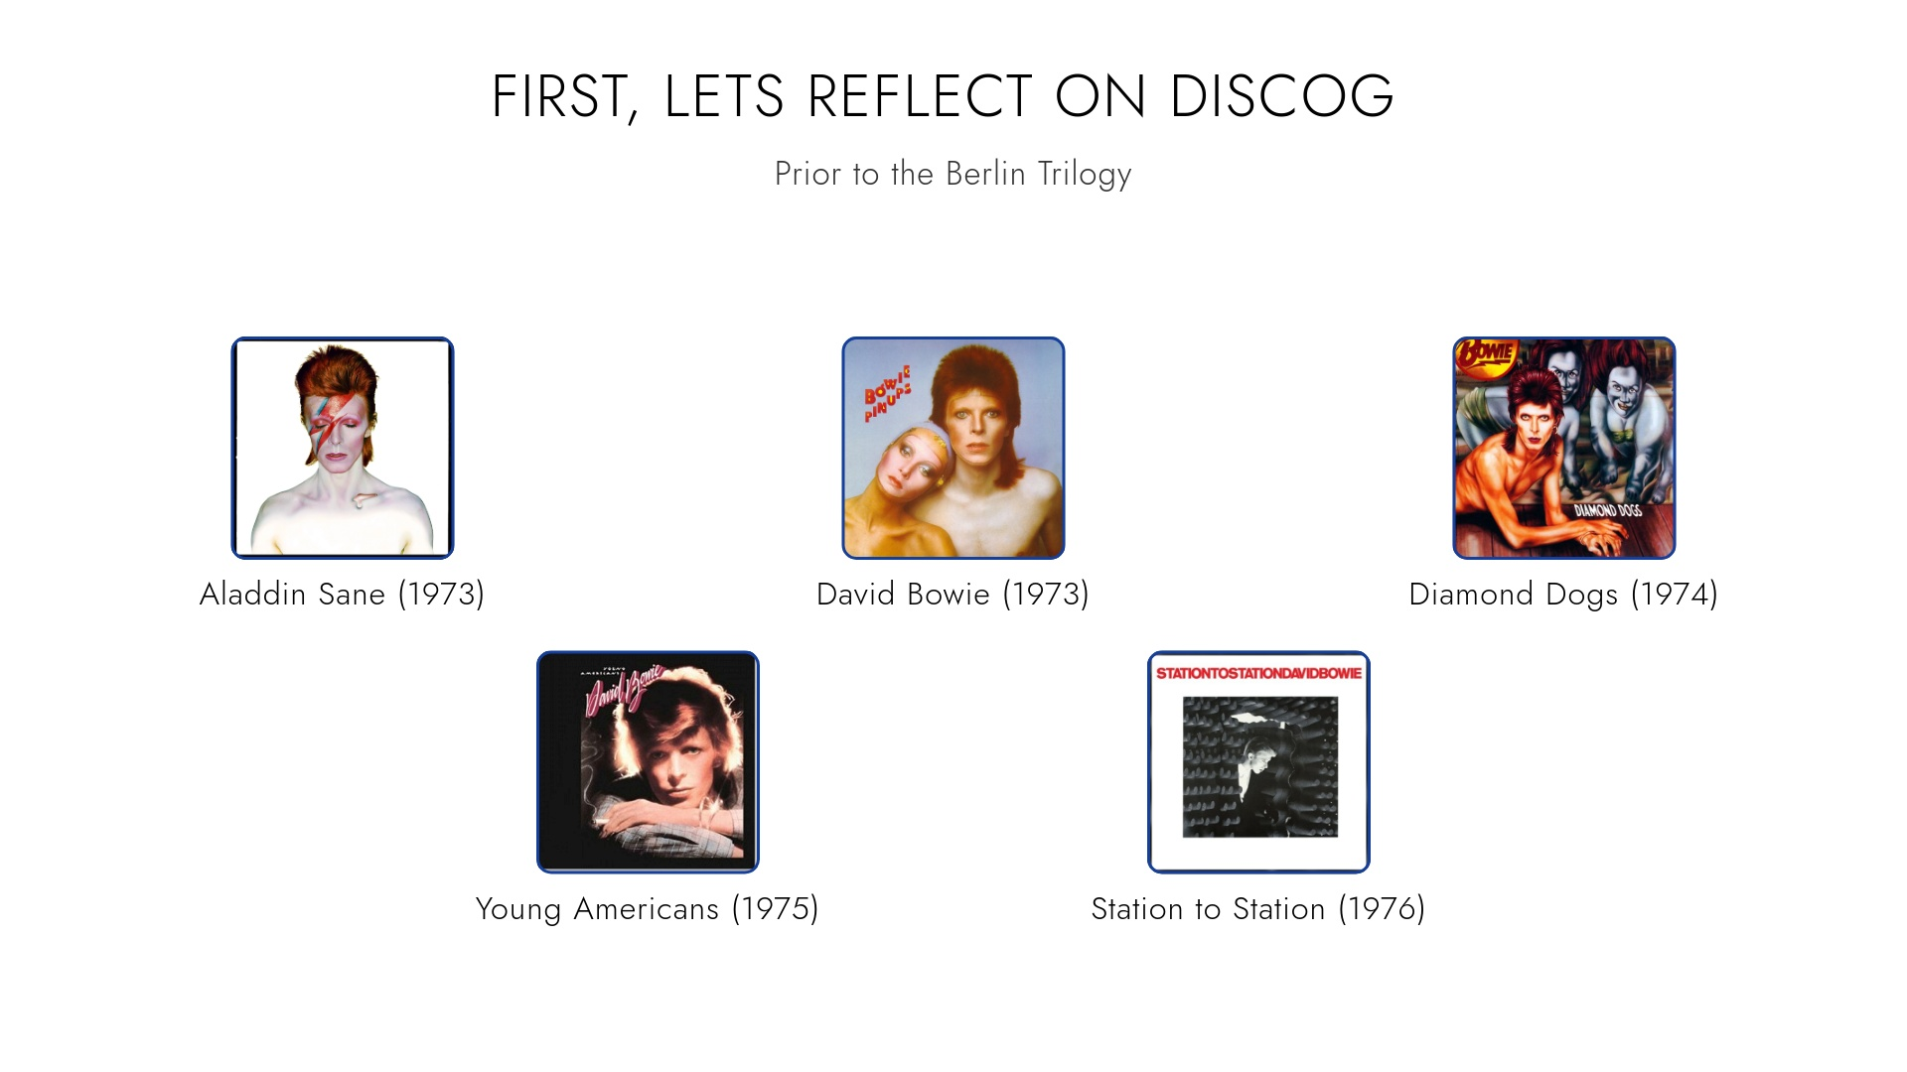

Slide 25
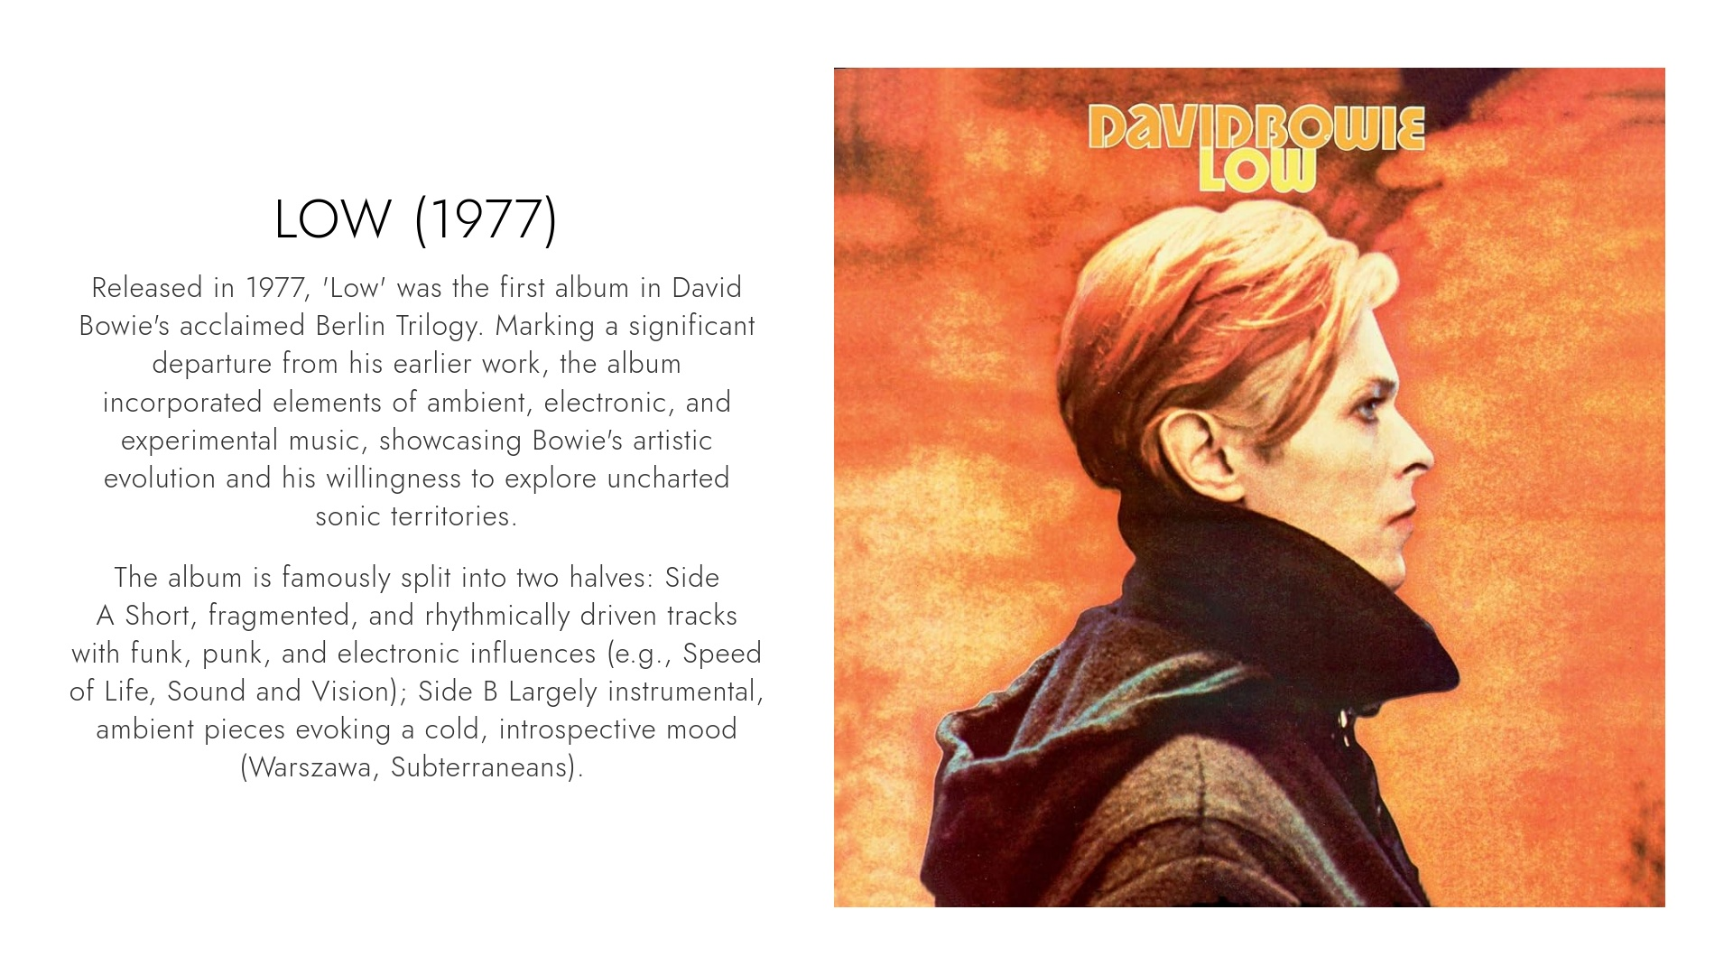

Slide 26
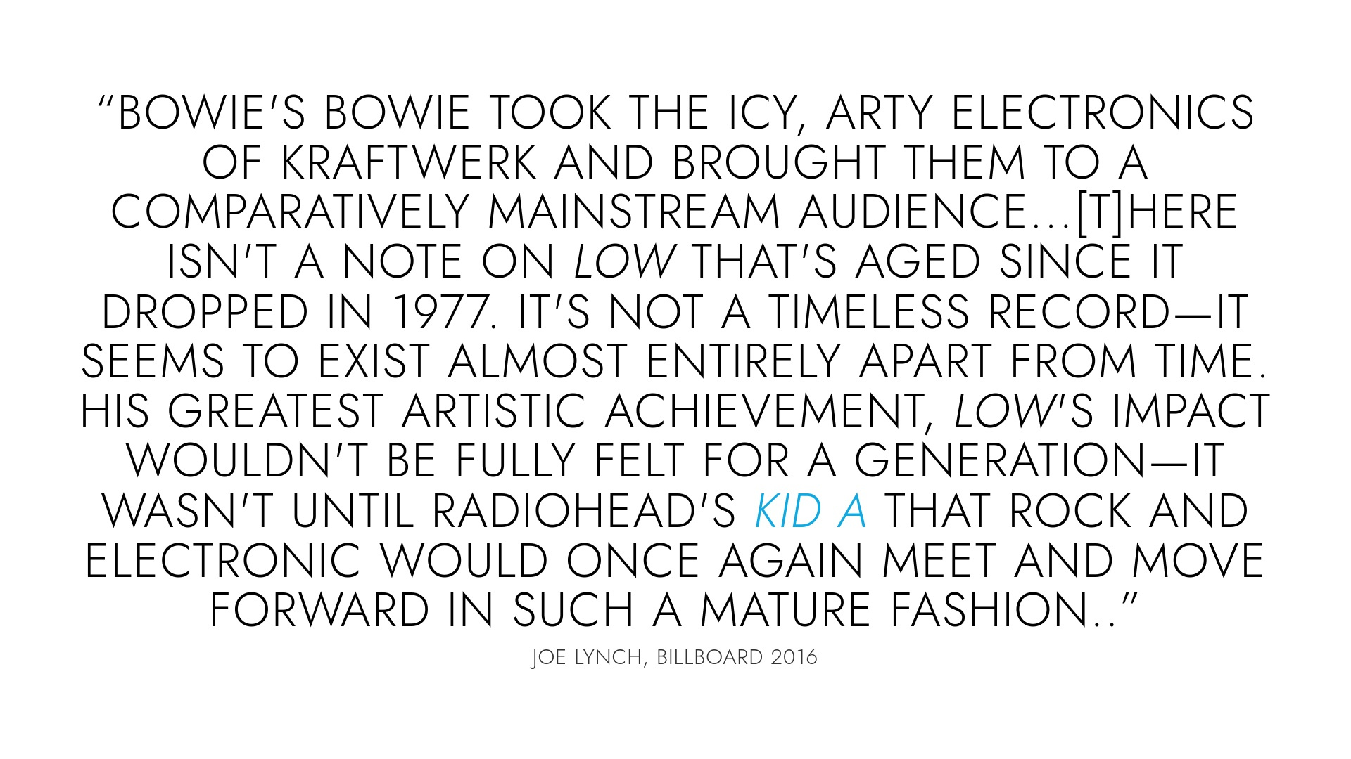

Slide 27
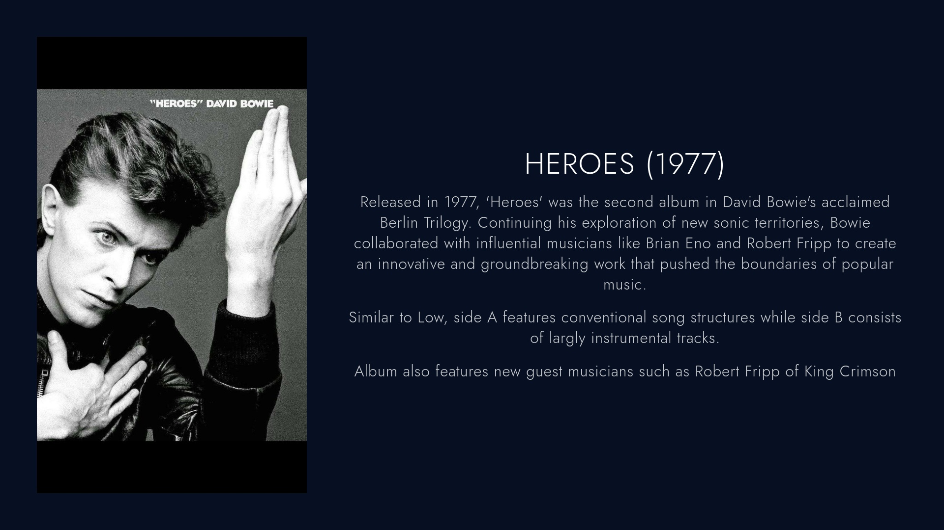

Slide 28
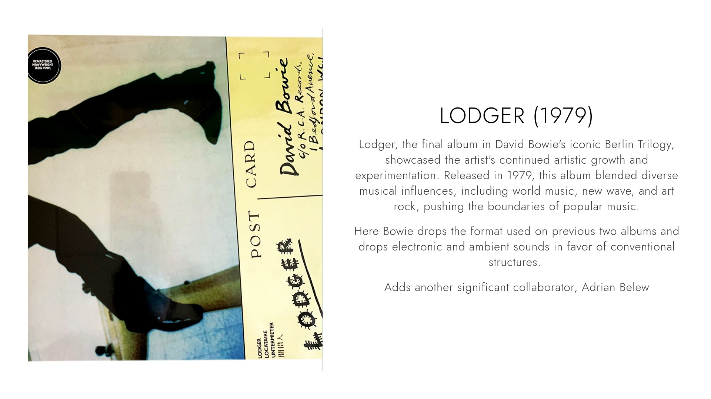

Slide 29
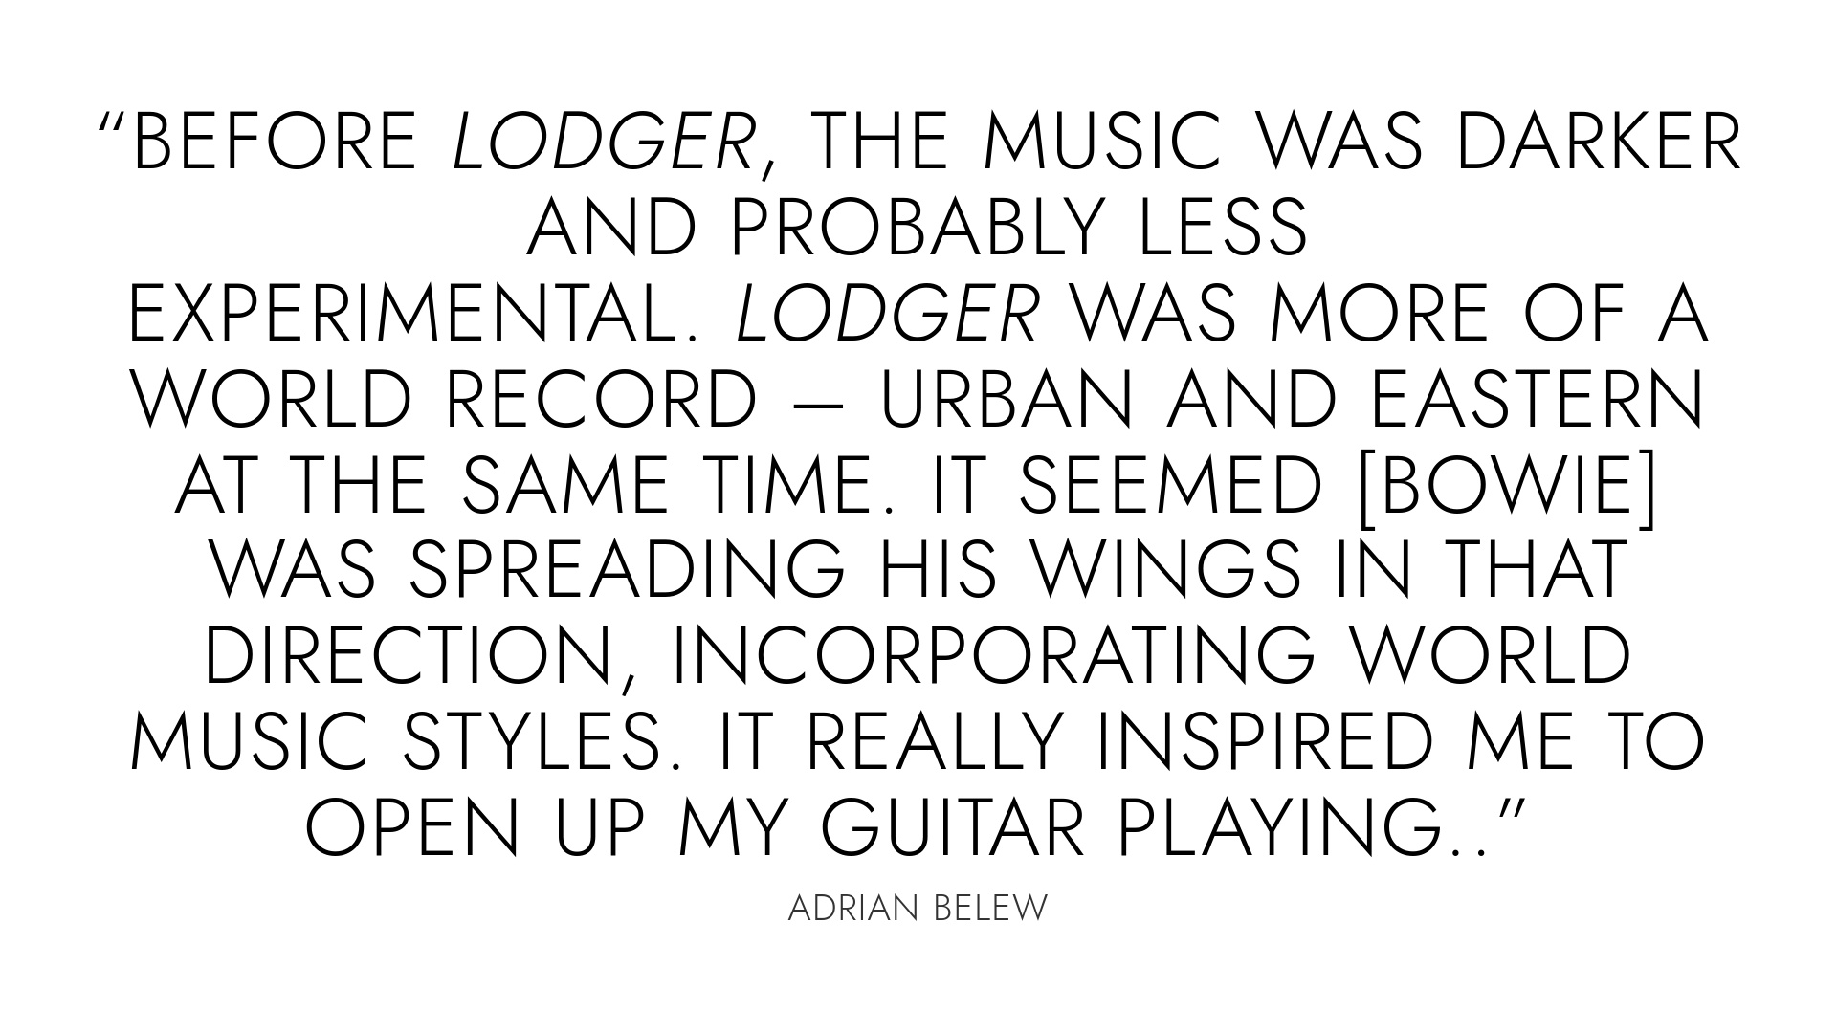

Slide 30
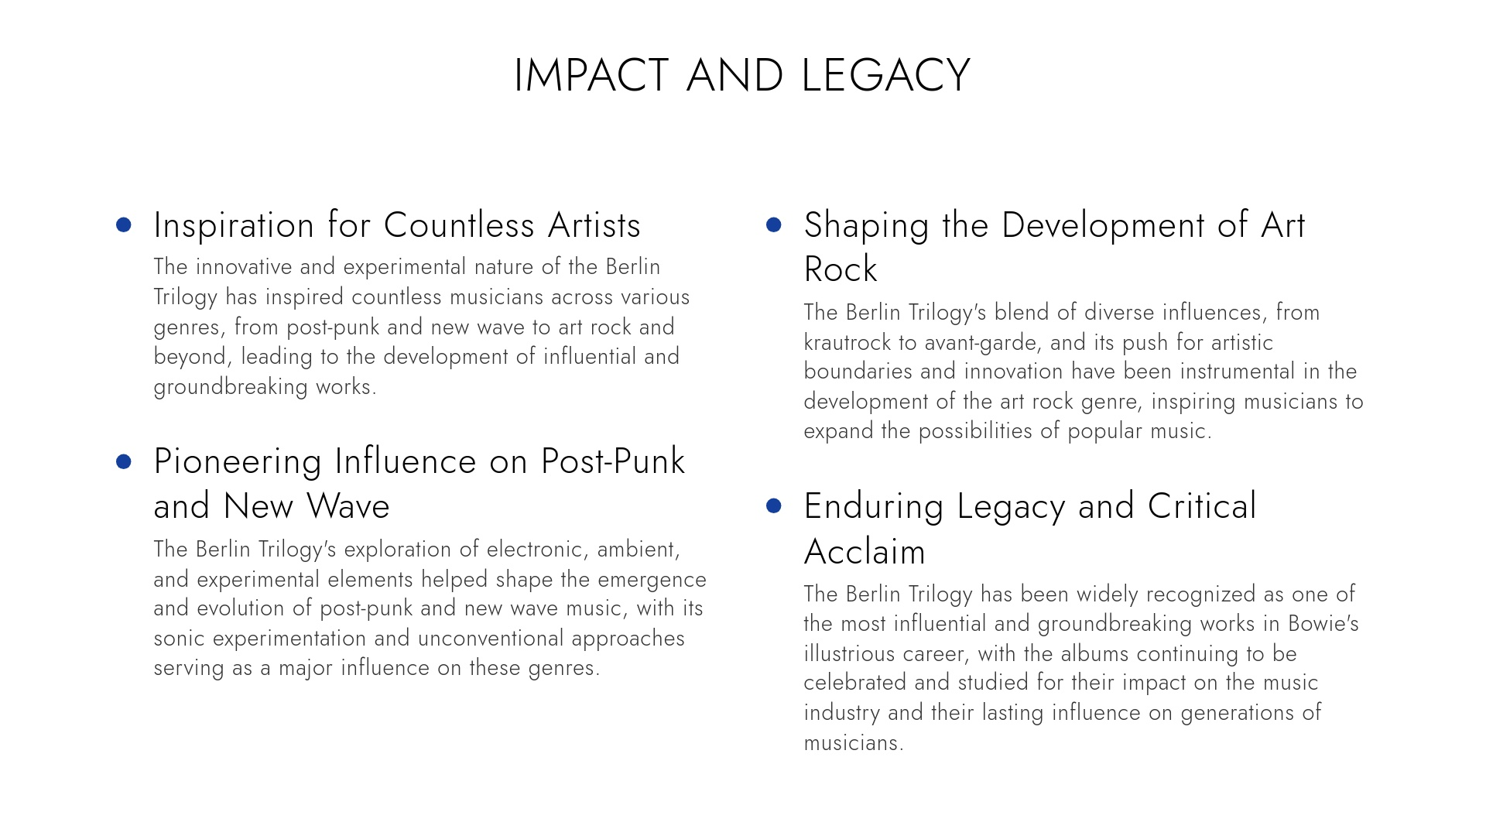

Slide 31
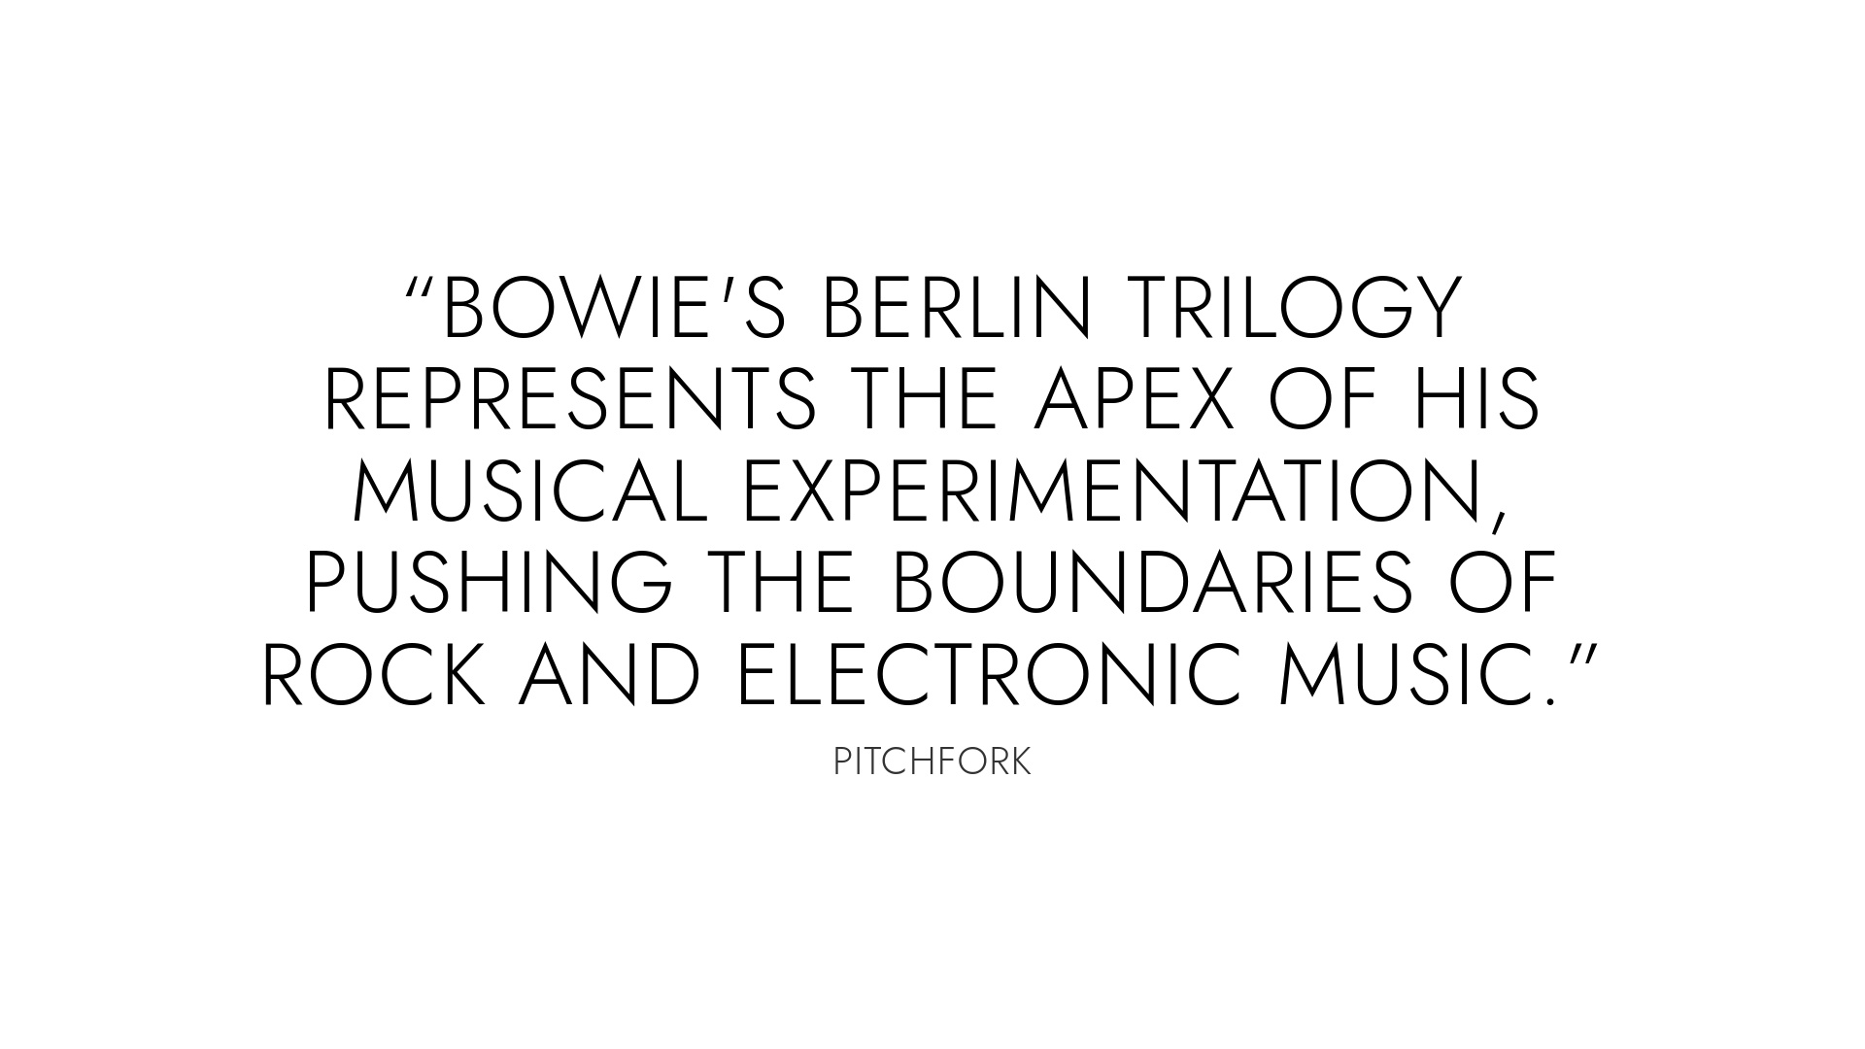

Slide 32
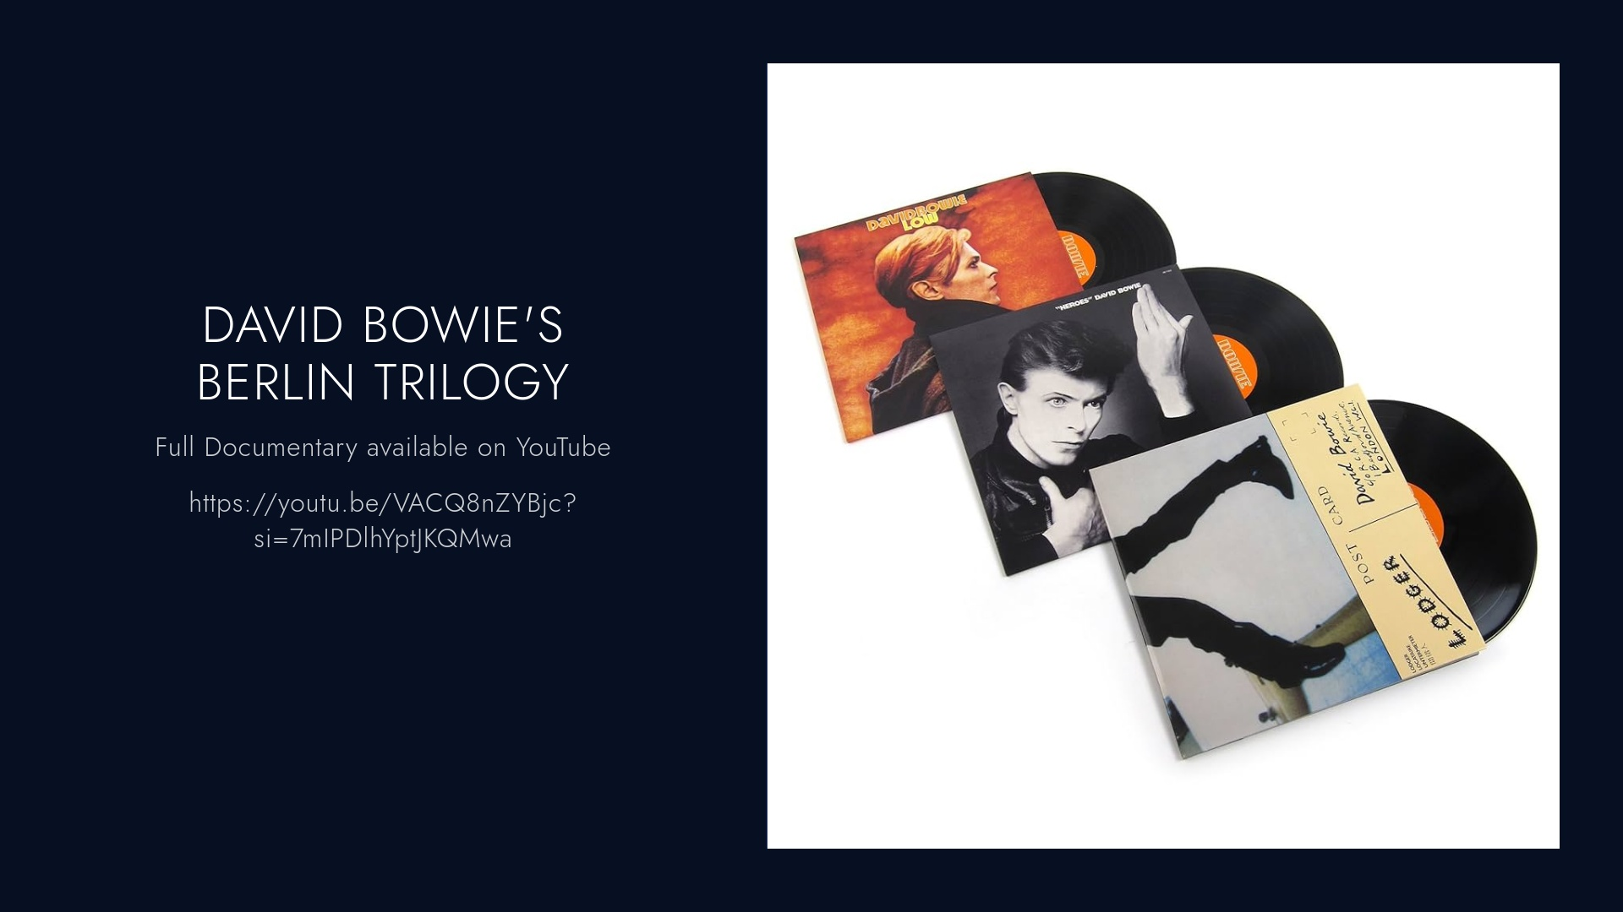

Slide 33
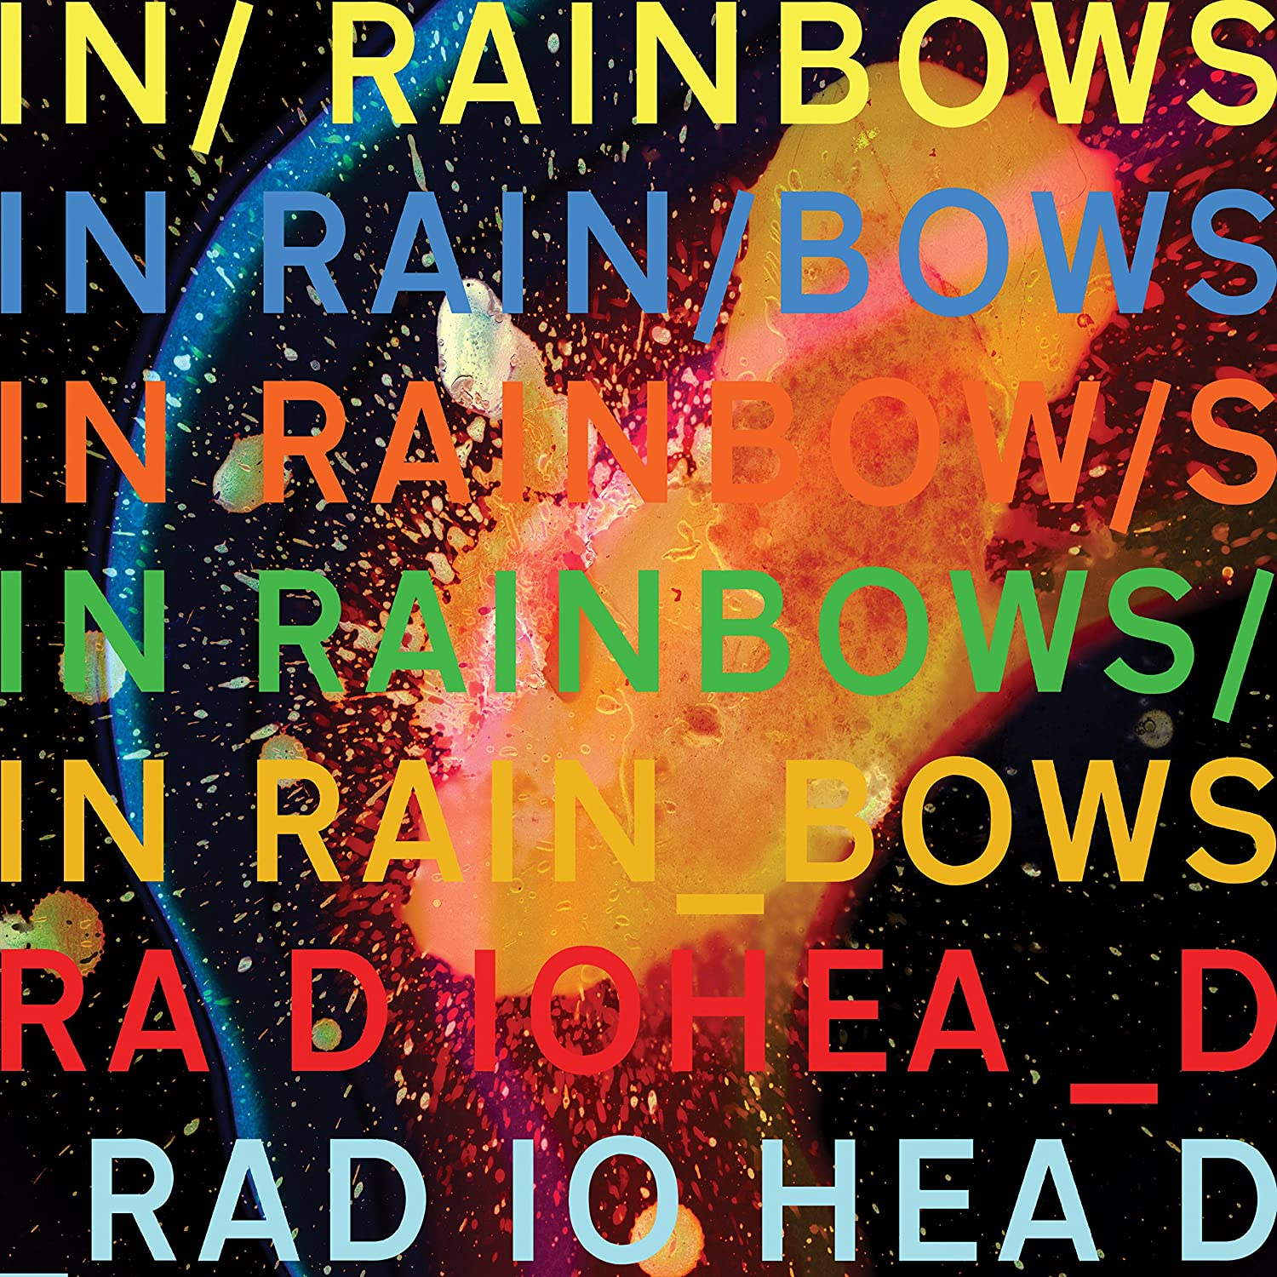
HEADLINER
Radiohead – In Rainbows
Released: October 10th, 2007
Recorded:
Halswell House, Somerset
Tottenham House, Wiltshire
The Hospital Club, London
Radiohead's studio, Oxfordshire
Label: Self released through XL and TBD (North America)
Producer: Nigel Godrich

Slide 34
HEADLINER
Radiohead – In Rainbows
In Rainbows is Radiohead’s seventh studio album. It was self released without prior notice and was available under a Pay-What-You-Want model to allow for greater access to the music.
The album was released after a three year hiatus following the Hail to the Thief tour. The band returned to the studio in 2005 but progress was slow with Yorks stating that the band felt like they were wasting time.
After a failed attempt to create an album with producer Spike Stent, Radiohead’s management suggested the band break-up. The band instead toured, which applied pressure on them to finish the new material.
After touring, the band started working with Nigel Goodrich and recorded the album at several studios across England over the end of 2006.
The album itself continues the layering and electronic influence of Kid A and Amnesiac but with more warmth and less dystopian lyrical content.

Slide 35
ROTATION
Chris
Joe
John
Adam
Lucas
Whoever is MC, they have music and booze, whoever is on deck, they have notes and food.

Slide 36
WRAP UP
Next Meeting
Date: June 12, 2025
Host – Music & Cocktails: Chris
Notes & Food: Joe
Final Thoughts

Slide 37
APPENDICES
For reference only

Slide 38
HISTORY
# | Date | MC | Cocktail | Selections
1 | 1/22/2015 | Chris | Sazerac | King Crimson In the Court of the Crimson King
2 | 2/26/2015 | Joe | Sidecar | Mountain Nantucket Sleighride
3 | 3/27/2015 | John | Rusty Nail | Sebado, Yo La Tengo, Ben Lee
4 | 4/23/2015 | Chris | Harvey Wallbanger | The Knife Silent Shout
5 | 7/29/2015 | Joe | Rum Ball | Jefferson Airplane Surrealistic Pillow, Talking Heads Talking Heads:77
6 | 11/5/2015 | John | Old Fashion | The Afghan Whigs Black Love
7 | 12/17/2015 | Chris | Between the Sheets | The Stooges Raw Power
8 | 1/26/2016 | Joe | Whiskey Sour | James Brown Say it Loud, David Bowie tribute
9 | 3/25/2016 | Lucas | Negroni | Paul Simon Graceland, Arcade Fire Funeral, Vampire Weekend Vampire Weekend
10 | 5/26/2016 | John | Bloody Mary | The Replacements Pleased to Meet You, The Jam Setting Sons, Big Star #1 Record

Slide 39
HISTORY
# | Date | MC | Cocktail | Selections
11 | 8/10/2016 | Chris | Stinger | Joy Division Unknown Pleasures, Genesis Selling England by the Pound, Radiohead A Moon Shaped Pool
12 | 9/29/2016 | Joe | Soft Wink | Adrian Belew Young Lions, Robin Trower Bridge of Sighs, Santana Moonflower
13 | 12/8/2016 | Lucas | The Magnificent Bastard | Frightened Rabbits Midnight Organ Fight, Leonard Cohen Personal Problems, Bob Dylan Blood on the Tracks
14 | 1/26/2017 | John | Manhattan | Galaxie 500 On Fire, Morphine Cure for Pain, Built to Spill Perfect from Now On
15 | 3/9/2017 | Chris | Vieux Carre | MC5 Kick Out the Jams, Mastodon Crack the Skye, Black Sabbath Black Sabbath Vol 4
16 | 5/4/2017 | Joe | Vodka Martini (Kangaroo) | Live Mental Jewelry, Kansas Leftoverture, Allman Brothers At Fillmore East
17 | 8/10/2017 | Lucas | The Sun Also Sets | Interpol Turn On The Bright Lights, Serge Gainsbourg & Jane Burkin Jane Burkin/Serge Gainsbourg, Modest Mouse The Moon & Antarctica
18 | 9/14/2017 | John | Moscow Mule | David Bowie Pinups, Steve Earle Townes: The Basics, Kurt Vile Believe I’m Going Down, (also played*John Mayer – Where the Light Is, Steely Dan – Aja)
19 | 10/26/2017 | Chris | The Aviation | Spoon Ga Ga Ga Ga Ga, Fleetwood Mac Rumours, R.E.M. Murmur
20 | 1/25/2018 | Joe | Black Russian | Widespread Panic - VCL Mix Edition, J. Geils - The Morning After, Jethro Tull - Thick As A Brick

Slide 40
HISTORY
# | Date | MC | Cocktail | Selections
21 | 3/8/2018 | Eric | Black Ginger | Stone Roses The Stone Roses, Grouplove Never Trust a Happy Song, The Wombats Beautiful People Will Ruin Your Life
22 | 5/10/2018 | John | Old Pal | Wilco Yankee Hotel Foxtrot, Pavement Slanted and Enchanted, Sonic Youth Daydream Nation
23 | 8/9/2018 | Adam | Hemingway Daiquiri | The Orwells Discgraceland, Sleater Kinney Dig Me Out, Pixies Doolittle
24 | 11/1/2018 | Lucas | The Packie | Los Campesinos No Blues, John Prine Bruised Orange
25 | 1/24/2019 | Chris | The Scofflaw | Led Zeppelin Led Zeppelin I, Led Zeppelin Led Zeppelin II
26 | 3/7/2019 | Joe | Hurricane | Mott The Hoople All The Young Dudes, Roy Buchanan That’s What I Am Here For
27 | 5/2/2019 | Eric | Dark & Stormy | Tears for Fears Elemental, Beck Guero
28 | 9/5/2019 | John | The Kentucky Buck | Dinosaur Jr You’re Living All Over Me, J. Mascis Elastic Days
29 | 10/7/2019 | Adam | Harvest Moon Old-Fashioned | Japandroids Celebration Rock, Arcade Fire Funeral
30 | 1/23/2020 | Lucas | French 75 | Father John Misty Fear Fun, Van Morrison Astral Weeks

Slide 41
HISTORY
# | Date | MC | Cocktail | Selections
31 | 6/11/2020 | Chris | Ward 8 | Band of Horses – Everything All the Time; Brand New – The Devil and God Are Raging Inside Me; TV on the Radio – Return to Cookie Mountain
32 | 8/6/2020 | Joe | Bourbon Tasting – Beam’s Choice Collector's Edition 50+; Carleton Tower 50+; Woodford Reserve Double Oaked | Arc Angels – Arc Angels; Yes – Close to the Edge; Good Night Lights – Biggest Fears
33 | 9/24/2020 | John | Vieux Carre | The Church – Starfish; Treepeople – Something Vicious for Tomorrow / Time Whore; Joe Strummer + The Mescaleros - Streetcore
34 | 11/19/2020 | Eric | Balvenie 14 Year Old Caribbean Cask Single Malt Scotch | Van Halen – 1984; Haim – Days Are Gone; The Smiths – Louder Than Bombs
35 | 3/11/2021 | Adam | Martinez | Nehiyawak – nipiy, Miles Cane – Coup de Grace, Afghan Whigs – Up In It
36 | 5/13/2021 | Chris | El Presidente | Television – Marquee Moon, Devo – Q: Are We Not Men? A: We Are Devo; The Clash – London Calling
37 | 6/10/2021 | Joe | The Penicillin | Leon Bridges – Coming Home; Billie Eilish – When We all Fall Asleep, Where Do We Go; Harry Styles – Fine Line
38 | 9/7/2021 | Eric | Blood + Sand | William Orbit – My Oracle Lives Uptown; The Connells – Steadman’s Wake; The Stranglers – Dark Matters
39 | 11/23/2021 | John | 81 Old Fashion | Dry Cleaning – New Long Leg; The War on Drugs – I Don’t Live Here Anymore; My Morning Jacket – My Morning Jacket
40 | 6/9/2022 | Chris | Tuxedo No. 2 | Depeche Mode – Speak & Spell; Kraftwerk – Computer World; The Police – Ghost in the Machine

Slide 42
HISTORY
# | Date | MC | Cocktail | Selections
41 | 7/14/2022 | Joe | Brown Derby | Beautiful Bob Seger – Live Bullet; Gil Scott-Heron – Pieces of a Man; Tears for Fears – Tipping Point
42 | 8/11/2022 | Eric | Painkiller | Echo & the bunnymen - Evergreen; Twenty One Pilots - Vessel; Metric - The Art of Doubt
43 | 9/15/2022 | John | Stone Fence | The Doors – The Doors; The Strokes – This is It
44 | 11/17/2022 | Adam | Cynar Flip | Ron Gallo - HEAVY META; The Foo Fighters – The Colour and the Shape
45 | 1/12/2023 | Lucas | Paloma | Sky Perriera – Night Time, My Time; Bloc Party – Silent Alarm
46 | 3/9/2023 | Chris | The Clover Club | Cut/Copy – In Ghost Colours; The Cure – Kiss Me, Kiss Me, Kiss Me
47 | 4/20/2023 | Joe | The New Fashioned | Supertramp – Crime of the Century; St. Paul & The Broken Bones – The Alien Coast; Sharon Jones & The Dap Kings – 100 Days 100 Nights
48 | 6/8/2023 | Eric | Eric’s Fancy | The Police - Zenyatta Mondatta; INXS – The Swing; Jackson Browne – Late For The Sky
49 | 7/13/2023 | John | El Diablo | Todd Rundgren - A Wizard / A True Star; Pink Floyd - Animals; Yo La Tengo - This Stupid World
50 | 9/21/2023 | Adam | Ginger Pear Bourbon | Nilüfer Yanya - PAINLESS, PJ Harvey - Stories from the City, Stories from the Sea; Yeah Yeah Yeahs - Fever to Tell

Slide 43
HISTORY
# | Date | MC | Cocktail | Selections
51 | 10/19/2023 | Lucas | Late Night Flight | Fall Out Boy – From Under the Cork Tree, Blink-182 – Blink-182, Taking Back Sunday – Tell All Your Friends
52 | 11/9/2023 | Chris | Turf Club | Killing Joke – Killing Joke; Tubeway Army – Tubeway Army; Nine Inch Nails – The Fragile
53 | 1/10/2024 | Joe | The Cape Codder | Neil Young & Crazy Horse at The Fillmore 1970; First Ever Film Presentation: The Last Waltz
54 | 3/14/2024 | Eric | Gold Rush | Johnny Marr + the Healers – Boomslang; Morrissey – Viva Hate; The Smiths – Hatful of Hollow
55 | 4/11/2024 | John | Godfather | Woods - Perennial; King Gizzard & the Lizard Wizard - Ice, Death, Planets, Lungs, Mushrooms and Lava; Neil Young - Chrome Dreams
56 | 5/9/2024 | Adam | Oaxaca Old Fashioned | Pet Fox - A Face in Your Life; Momma - Household Name; Shame - Songs of Praise
57 | 9/12/2024 | Lucas | Remember the Maine | Bloc Party – A Weekend in the City, Maximo Park – A Certain Trigger, Futureheads – Futureheads (Self Titled)
58 | 10/10/2024 | Chris | Toronto Sour
59 | 11/21/2024 | Joe | Blackberry Smash
60 | 1/9/2025 | John | Pendergast

Slide 44
HISTORY
# | Date | MC | Cocktail | Selections
61 | 3/13/2025 | Adam | Bubby’s Barrel-Aged Manhattan - Elijah Craig Small Batch Edition | Phantom Planet – Phantom Planet, MGMT – Loss of Life, The Beatles – Magical Mystery Tour
62 | 5/22/2025 | Lucas |  | Nirvana – Incesticide, Manchester Orchestra – A Black Mile to the Surface, Radiohead – In Rainbows

Slide 45
MUSICOLOGY HISTORY
Date | Host | Musicologist | Topic | Notes
1/22/15 | Chris
2/26/15 | Joe
3/27/15 | John
4/23/15 | Chris
7/29/15 | Joe
11/5/15 | John
12/17/15 | Chris |  |  | 1st Presentation deck
1/26/16 | Joe
3/25/16 | Lucas | Joe |  | 1st Reference to "Resident Musicologist, Joseph Ziegler report"
5/25/16 | John | Joe |  | 2nd Reference to "Resident Musicologist…"

Slide 46
MUSICOLOGY HISTORY
Date | Host | Musicologist | Topic | Notes
8/10/16 | Chris | Joe |  | Resident Musicologist Report reference
9/29/16 | John | Joe | Musicians Moving On
12/8/16 | Lucas | Joe | JZ Has the Floor
1/26/17 | John | Joe | The Philadelphia Sound
3/9/17 | Chris | Joe | Black Sabbath
5/4/17 | Joe | Joe | Beatles or Stones?
8/10/17 | Lucas | Joe | Bill Graham
9/14/17 | John | Joe | Glyn Johns Engineer, Producer, Mixer
10/26/17 | Chris | Joe | Behind the kit - 1971
1/25/18 | Joe | Joe | Emotional Response to Music

Slide 47
MUSICOLOGY HISTORY
Date | Host | Musicologist | Topic | Notes
3/8/18 | Eric | Joe | Disco deserves 10 minutes of our time
5/10/18 | John | Joe | The shame of the rock & roll hall of fame
8/8/18 | Adam | Joe | Pick one timeless song
11/1/18 | Lucas | Joe | AC/DC How fucked up IS this band?
1/24/19 | Chris | Joe | Number 1 song the day you were born
3/7/19 | Joe | Joe | How music affects the brain
5/2/19 | Eric | Joe | Sex, drugs, and Rock & Roll - Where did the phrase come from … beyond the obvious?
9/5/19 | John | Joe | Someone stole my song! Plagerism in Rock & Roll
10/17/19 | Adam | Joe | Contract riders - Excess and entitlement in Rock & Roll
1/23/20 | Lucas | Joe | Groupies! Ah… the ladies

Slide 48
MUSICOLOGY HISTORY
Date | Host | Musicologist | Topic | Notes
6/11/20 | Chris | Joe |  | ***Musicology was tabled until the next meeting
9/24/20 | John | Joe | Ployrythms and Polymeters - At the risk of being fired as a Musicologist…
11/19/20 | Eric | Joe |  | ***unclear what topic was covered
3/11/21 | Adam | Joe | Hilarious Band Names - Weevie Stonder
5/13/21 | Chris | Joe | Who Would You Pick? If you could see one show/performance of a person or band that is dead or broken up, who and why?
6/10/21 | Joe | Joe | Time Signature - it's fucking hard
9/7/21 | Eric | Joe | Breaking Music in television
11/23/21 | John | Joe | Famous musicians from Toledo OH
4/14/22 | Adam | Joe | RIP Michael Lang - Woodstock 1969
6/9/22 | Chris | Joe | Glen Campbell

Slide 49
MUSICOLOGY HISTORY
Date | Host | Musicologist | Topic | Notes
11/17/22 | Adam | Joe | Akron Porch Rocker!
1/12/23 | Lucas | Joe | Albums of the year
3/9/23 | Chris | Joe | Top Selling albums all time!
4/20/23 | Joe | Joe | Who got paid WHAT? At Woodstock 1969
6/8/23 | Eric | Joe | Stevie Moore - The Godfather of home recording
7/13/23 | John | Joe | Now famous backup singers
9/21/23 | Adam | Joe | Repeated lines in songs
10/19/23 | Lucas | Joe | Musical heroes
11/9/23 | Chris | Joe | The Band
1/10/24 | Joe | Joe | Movie Night! - The Last Waltz

Slide 50
MUSICOLOGY HISTORY
Date | Host | Musicologist | Topic | Notes
3/14/24 | Eric | Joe | Where did Rock come from?
4/11/24 | John |  |  | ***No musicology conducted - Changing of the arms
5/9/24 | Adam | Chris | 1994 – The Pinnacle of Alternative Rock?
9/12/24 | Lucas | Chris | The Krautrock Influence on music in the 1970s and beyond
10/10/24 | Chris | Joe | Frontman
11/21/24 | Joe | Chris | Quincy Jones
1/9/25 | John | Chris | Top 5 analysis
3/13/25 | Adam | Chris | David Bowie’s Berlin Trilogy

